Slide 1


INTERNSHIP REVIEW
SRI RAMAKRISHNA ENGINEERING COLLEGE
[Educational Service : SNR Sons Charitable Trust]
Vattamalaipalayam, N.G.G.O. Colony Post,
Coimbatore – 641022
JEE DROPOUT ANALYSIS
Presented by
2301006-ADVAITH G

Slide 2
Agenda
Company
profile
Project details
Project modules
Project Screenshots
Summary
Presentation Title

Slide 3

COMPANY PROFILE
Company Name: NextLogic Software Solutions Company Location: Coimbatore, Tamil Nadu.
Company Description:
NextLogic Software Solutions, commonly known as Nxtlogic, is a technology and research-oriented company headquartered in Coimbatore, Tamil Nadu, India, established in 2009. It is a technology-driven organization that provides software development, artificial intelligence, machine learning solutions, and industry-focused training. NextLogic focuses on turning innovative ideas into powerful digital outcomes through a combination of cutting-edge technologies and practical expertise.
Services Offered:
Web Development
Software Development
Mobile App Development
AIML

Slide 4

PROJECT DETAILS
To develop a Machine Learning–based system that predicts whether a student is likely to drop out after Class 12 based on academic performance, preparation patterns, and personal factors. The system aims to support early identification of at-risk students and enable timely academic intervention.
The platform is designed as a user-friendly web application where users can input student details and receive a real-time prediction indicating Dropout or Not Dropout. The application integrates a trained Machine Learning model with a Flask backend to ensure accurate and reliable predictions.
Frontend Technologies
Backend Technologies
HTML
CSS
JS
Python
Flask
Machine Learning
Scikit-Learn
Pandas
Numpy
MatplotLib
Internship Review

Slide 5
PROJECT MODULES
User Interface Module:
The User Interface (UI) serves as the interaction point between the user and the system as shown Fig 1. It is designed to be simple and intuitive so that even users without technical knowledge can easily use the application.
• Provides input fields for entering student-related data
• Ensures proper validation of user inputs
• Displays prediction results clearlyproducts from the catalog
Data Input Module
This module is responsible for collecting student data required for prediction as shown in Fig 2. The inputs include academic performance indicators and preparation-related parameters.
• Accepts numerical and categorical inputs
• Performs basic validation before sending data to the backend
• Ensures consistency with the training dataset

Slide 6
PROJECT MODULES
Data Preprocessing Module
The dataset used for the JEE Dropout Prediction System is a CSV as shown in Fig 3 file containing academic and preparation-related attributes such as JEE scores, mock test scores, school board, coaching type, study hours, and the target variable dropout. The dataset was examined to identify missing values, inconsistencies, and noise. Categorical features were encoded into numerical form, missing and inconsistent values were handled, and extreme values were treated during Exploratory Data Analysis (EDA). Numerical features were scaled to ensure uniform contribution during model training, improving overall model reliability
Machine Learning Model Module
The Machine Learning Model Module is the core component of the JEE Dropout Prediction System, responsible for analyzing processed student data and generating predictions. In this module, multiple classical Machine Learning algorithms such as Logistic Regression, Decision Tree, Random Forest, K-Nearest Neighbors (KNN), Support Vector Machine (SVM) were implemented. Each model was trained using the preprocessed dataset and evaluated using appropriate performance metrics

Slide 7
PROJECT MODULES
Model Evaluation Module
The Model Evaluation Module was used to compare the performance of different Machine Learning algorithms implemented in the JEE Dropout Prediction System. Models such as Logistic Regression, Decision Tree, Random Forest, SVM, and KNN were evaluated using Accuracy, Precision, Recall, and F1-score to ensure reliable classification. From the performance comparison as shown in Fig 4, Decision Tree and Random Forest models showed the best results across all evaluation metrics. Logistic Regression exhibited lower recall and F1-score, while SVM and KNN produced moderate performance . The Decision Tree model was selected for deployment due to its high accuracy and consistent results.
Backend (Flask) Module
The Backend Module of the JEE Dropout Prediction System is implemented using the Flask framework, which acts as a bridge between the user interface and the Machine Learning model. It is responsible for handling user requests, processing input data, and generating prediction results

Slide 8
PROJECT MODULES
Model Serialization Module
The Model Serialization Module is used to store the trained Machine Learning model so that it can be reused without retraining. After the model was trained and evaluated, it was saved using the joblib library, which allows efficient storage of Machine Learning objects
Result Display Module
The Result Display Module is responsible for presenting the prediction output to the user in a clear and understandable manner. After the Machine Learning model processes the input data, the prediction result is sent from the backend to the frontend for display. The system displays whether the student is predicted to “Dropout” or “Not Dropout” based on the model’s output.

Slide 9
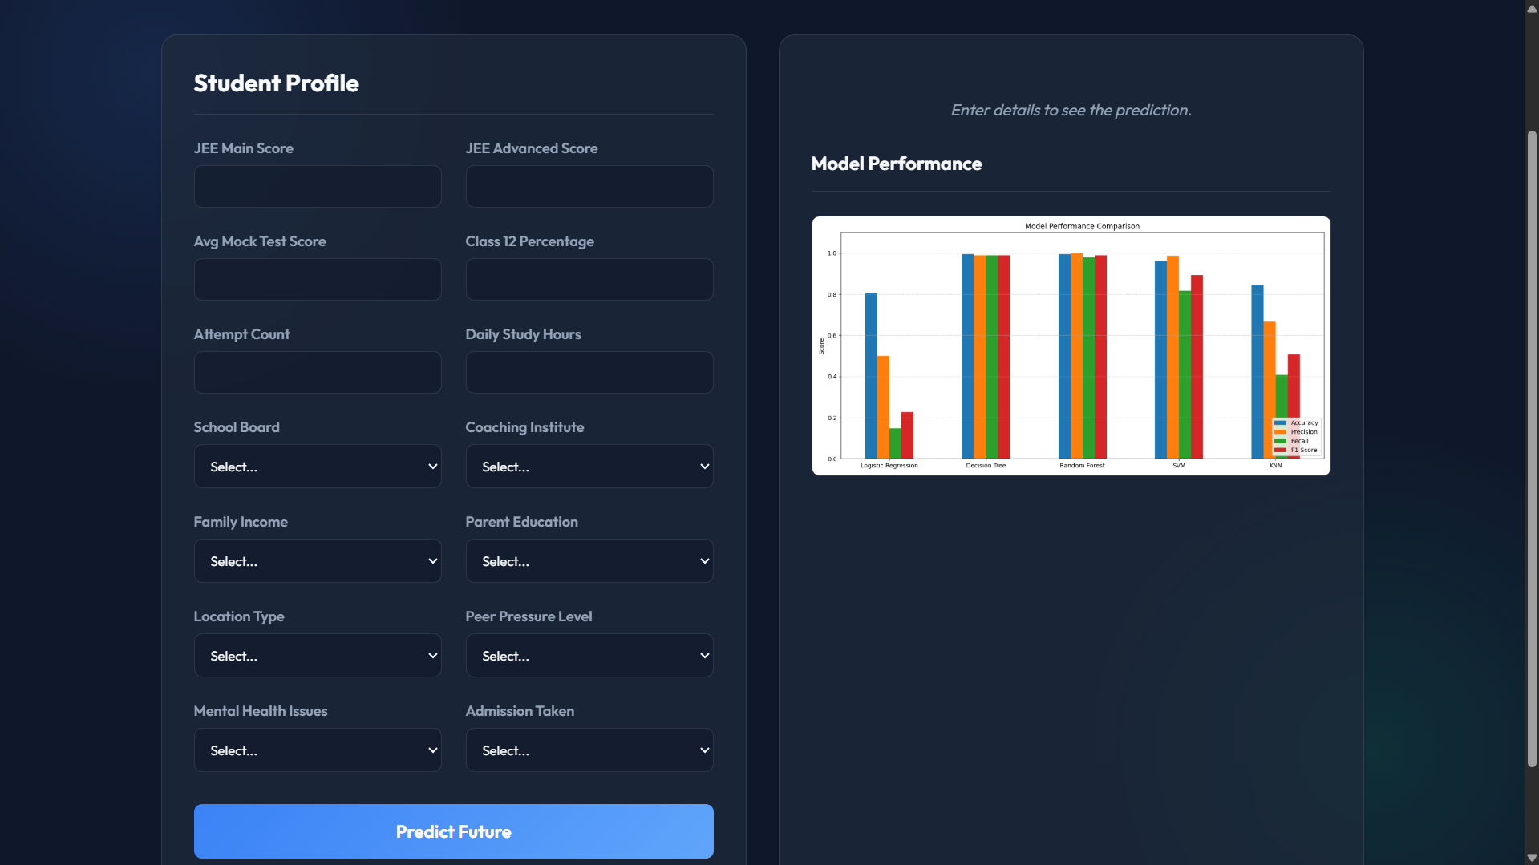
PROJECT SCREENSHOT
Fig. 1 User Interface

Slide 10
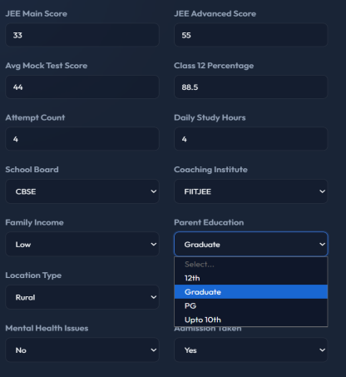
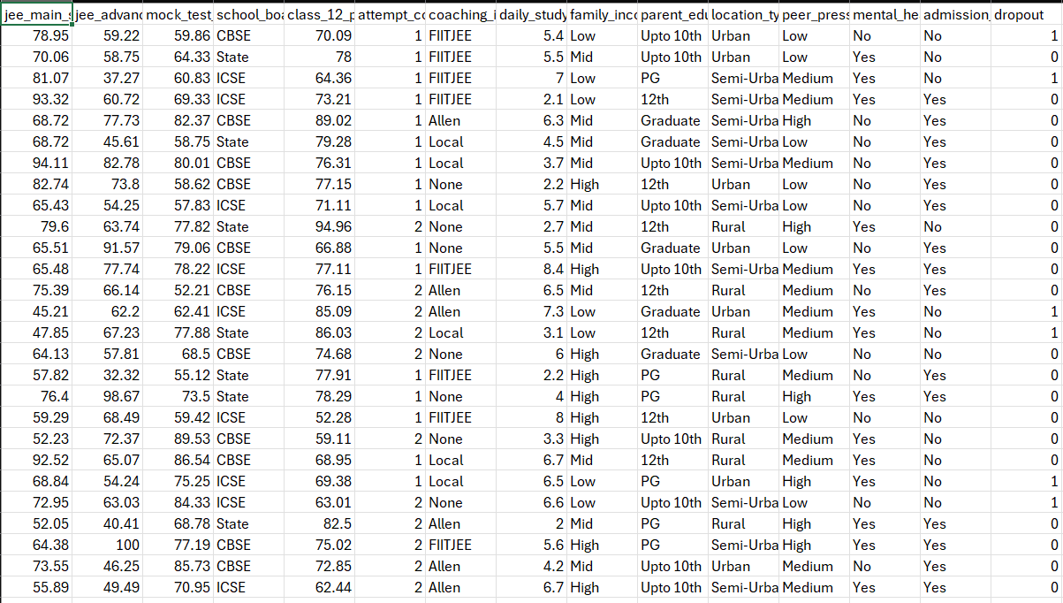
PROJECT SCREENSHOT
Fig. 2 Data Input
Fig. 3 Data Preprocessing

Slide 11
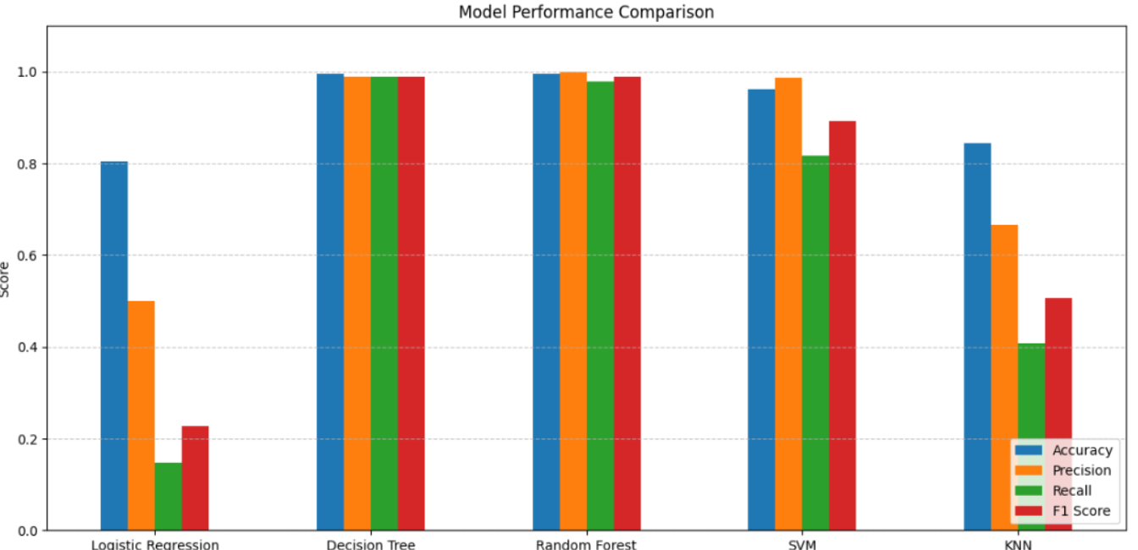
PROJECT SCREENSHOT
Fig. 4 Model Comparison

Slide 12
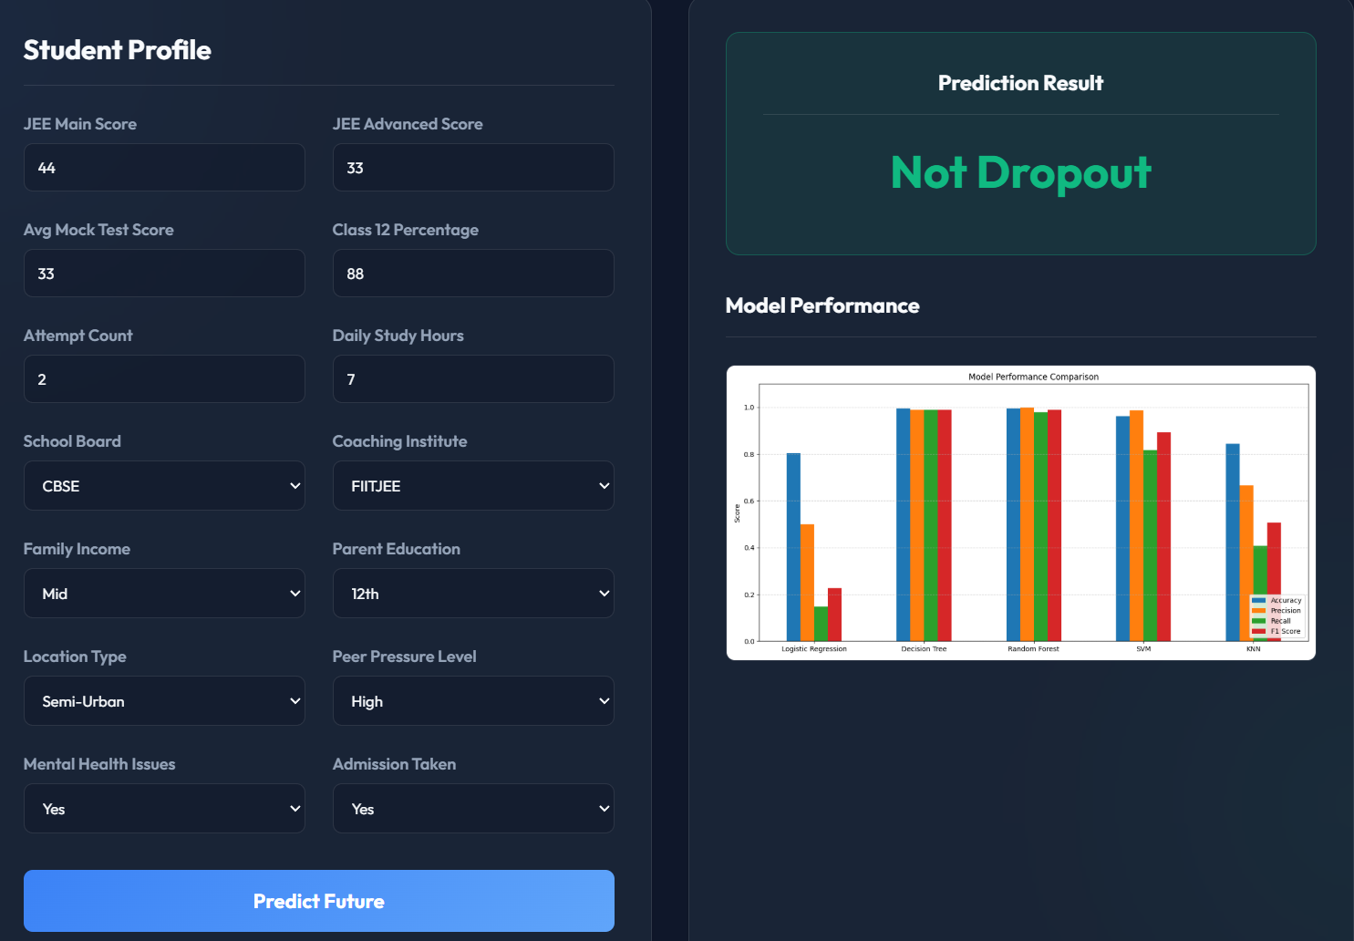
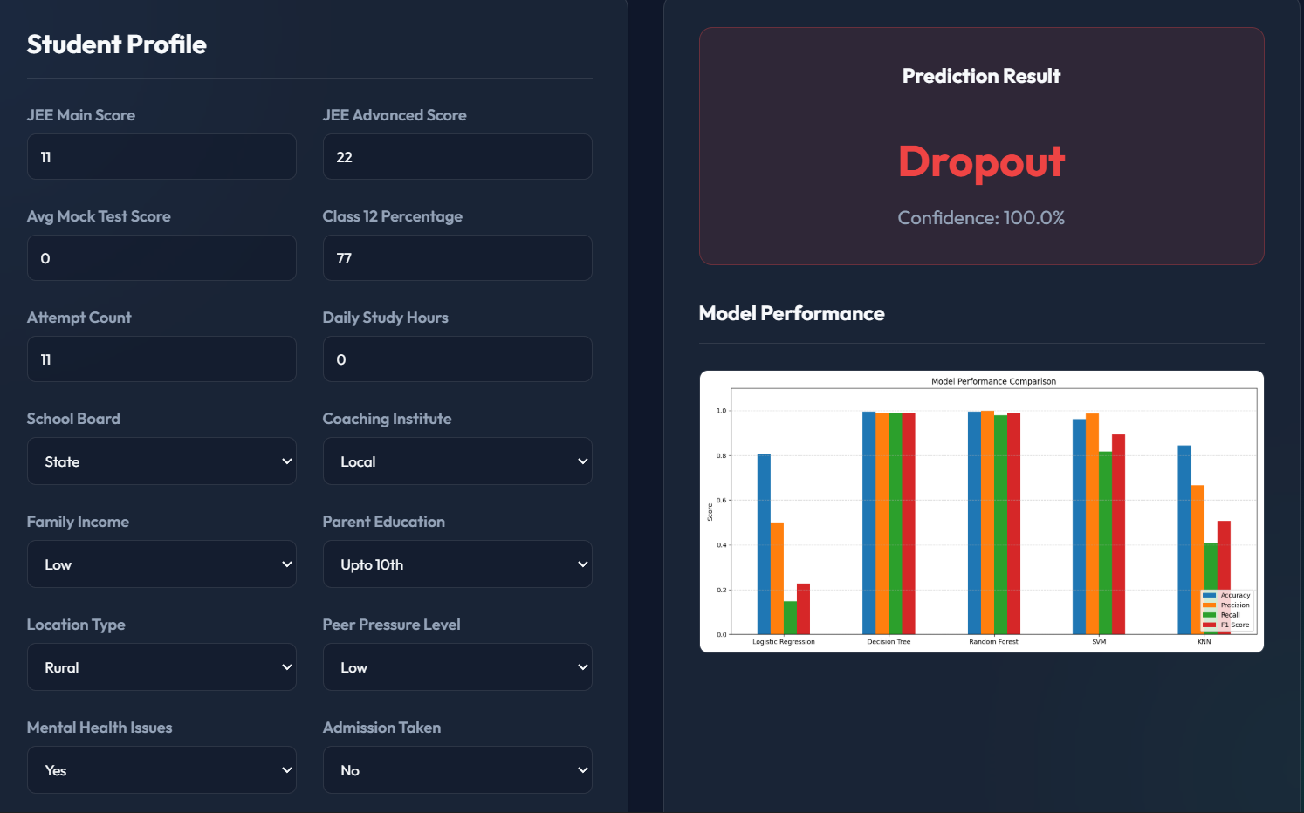
PROJECT SCREENSHOT
Fig. 5 Model Prediction

Slide 13
SUMMARY
From the analysis and implementation carried out during the internship, it is evident that Machine Learning techniques can be effectively applied in the education domain to address real-world problems such as student dropout prediction. The JEE Dropout Prediction System demonstrates how academic and preparation-related data can be converted into meaningful insights to support early intervention and informed decision-making.
The project involved implementing and evaluating multiple Machine Learning algorithms to identify the most suitable model for prediction. This helped in understanding the importance of data preprocessing, feature selection, and evaluation metrics in building reliable predictive systems. The successful deployment of the model as a web application highlights the practical usability of Machine Learning in real-world environments.

Slide 14




Thank you

